Slide 1
The Demographic
Transition
Community Health Strand

Slide 2
Through history, population grew very little
because there were nearly as many
deaths as births each year.
High birth rates were often off set by wars,
famines and epidemics.
China and Europe lost one third of their
population due to the bubonic plague
during the 14th century.

Slide 3
Health and living conditions improved
during the 17th and 18th centuries.
The number of births exceeded the number of deaths and populations began
to grow.
Better hygiene and public sanitation
reduced the incidence of disease.
Expanded commerce made food supply
more widely available and improved
nutrition.

Slide 4
Life expectancy began a slow raise, while birth
rates also declined as a result of later ages at marriage, urbanization, industrialization, rising
aspirations and other factors.
The shift from high to low mortality and fertility is
known as “the demographic transition.”
The shift occurred in Europe, North America and
a number of other areas during the 19th and 20th
centuries, and in developing countries during the
mid 20th century.

Slide 5
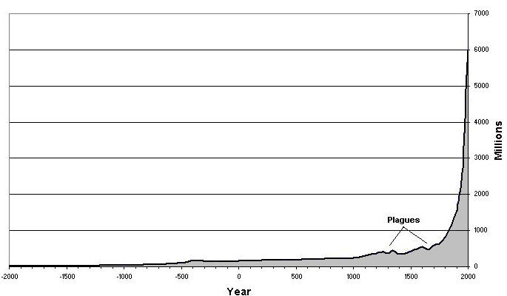

World Population

Slide 6
World Population Growth
1 billion – 1804
2 billion – 1927 (123 years)
3 billion – 1960 (33 years)
4 billion – 1974 (14 years)
5 billion – 1987 (13 years)
6 billion – 1999 (12 years)

Slide 7
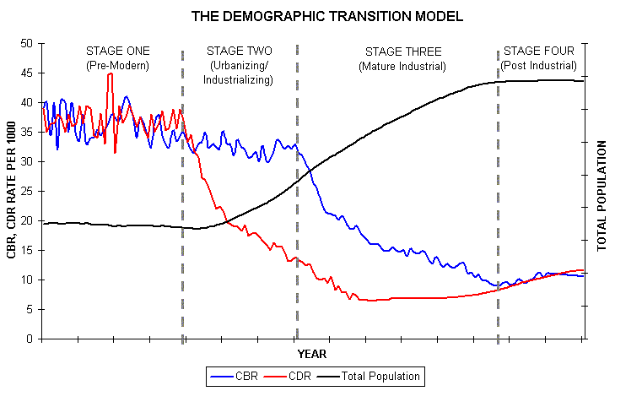
Demographic Transition

Slide 8
STAGE ONE (High Stationary)
characterized by a balance between birth rates and death rates. This situation was true of all human populations up until the late 18th.C. when the balance was broken in western Europe.
Birth and death rates are both very high (30-50 per thousand). Their approximate balance results in only very slow population growth

Slide 9
STAGE TWO ( Early Expanding)
sees a rise in population caused by a decline in the death rate while the birth rate remains high, or perhaps even rises slightly
increasingly rapid rise in population growth (a "population explosion") as the gap between deaths and births grows wider

Slide 10
STAGE THREE (Late Expanding)
moves the population towards stability through a decline in the birth rate.

Slide 11
STAGE FOUR (Low Stationery)
characterized by stability. In this stage the population age structure has become older.
STAGE FIVE (Declining)
In this stage birth rate is lower than death rate and the population size is decreasing

Slide 12
In summary
high birth rates and death rates are disrupted by
a long-term decline in mortality. Mortality rates eventually stabilize at low levels.
Birth rates then fall to about the same level as
mortality rates. With birth and death rates at
similar low levels, the equilibrium as slow
population growth is regained.

Slide 13
Second Demographic Transition:
Where fertility falls below the two-child
replacement level as forces of contemporary life
interfere with childbearing.
Reasons may be that; greater educational and job opportunities for women, the availability of
effective contraception, legalization of abortion (not in SL), shift away from formal marriage, acceptance of childbearing outside marriage etc.

Slide 14
The Reproductive Revolution
Began in the second half of the 20th century.
Emergence of modern contraceptive methods, such as hormonal pills, intrauterine devices, simpler sterilization techniques, and contraceptives that can be injected or implanted under the skin made it easier and safer for women to avoid unintended pregnancies.

Slide 15
Increased access to such methods, along
with socioeconomic changes that motivated couples to have fewer children, drove the fertility decline of the last 40 years.
Contraceptive use worldwide rose from
less than 10% in the 1960s, to about 60%
in 2003.
Due to contraception, fertility decline occurred much faster in developing countries than it had in the industrialized countries.

Slide 16
It took the U.S and Europe 100 to 150 years to reduce family size……
Yet it only took a few decades in developing countries due to the introduction to contraception among other
factors.
Other factors:
Change in attitudes
Higher education
Late marriage
Couples want fewer children

Slide 17
For example:
In Kenya during the 1970’s women wanted seven or more children on average.
During the 1990’s they wanted fewer than
four children, on average.

Slide 18
Family Planning Programmes
Organized family planning programs brought contraceptive supplies and services to people, along with information campaigns promoting smaller families, healthier families, contributed substantially to smaller families in developing countries.
Such programs were responsible for 40 to 50 % of the fertility decline of developing countries since the 1960’s.

Slide 19
Why women don’t use contraceptives? (unmet need)
Fear of side effects of contraceptive
methods.
Fear of husband’s disapproval or
retribution
Religious opposition to family planning
Perceived risk of becoming pregnant/ Ambivalent feelings about becoming pregnant

Slide 20
Political and cultural barriers to family planning
Unmarried adolescents are denied access
to family planning to avoid promoting promiscuity.
Young married women are often encountered to give birth soon after marriage.

Slide 21
Mortality decline
HIV / AIDS infection
Has reduced life expectancy in some countries in sub-Saharan Africa
Infection rates are increasingly rapidly in South and East Asia.
In 2003, 98% of the 3 million HIV / AIDS deaths took place in sub-Saharan Africa
and other less developed regions.

Slide 22
Immigration and Urbanization
Migration affects population growth.
Migration affects the distribution of the
population by age, sex, cultural, racial, and
other characteristics in the communities
that send and receive immigrants.

Slide 23
Economic Development
Centered in Urban Areas
Cities offered better…..
-Job opportunities
-Amenities
-Public services
…………………..than rural areas.
By 1950, more than one half of residents of
developed countries lived in urban areas, from
about ¼ in 1900.
In 2000, 75% lived in urban areas.

Slide 24
International Migration
About 175 million people (3 % of the
world population are international migrants.
Most migrants are from developing
counties and migrate to more industrialized countries.
80 % of the world population live in
developing nations.

Slide 25
Why migrate?
Economic reasons
Refugees who were forced to leave their country because of political violence, or the threat of persecution.
Social networks also contribute to the
flows.

Slide 26
International migration flows
From South and Central America to North
America.
From North Africa and the Middle East to
Europe.
From Asia to Australia and North America.

Slide 27
Current Trends in SL
TFR was 1.9 in 2001
Below Replacement Level Fertility
Large proportion of economically active
Population aging
Higher female life expectancy

